Slide 1

PathFinder KE: Gamified Career Exploration for African Students
Matching students’ interests with real-world careers using local data.
Empowering young learners to make informed career decisions for a brighter future.

Slide 2

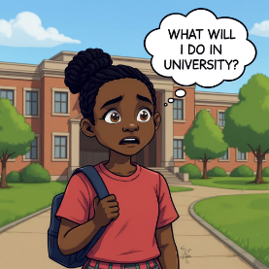
Problem Statement
Many students in Kenya and across Africa lack access to appropriate, personalized career guidance, leading to poor academic choices, missed opportunities, and long-term struggles in the job market.
User Persona: Aisha
Root Causes
Bright student unsure about career paths.
Limited career guidance in schools
"I’m passionate about science… but I don’t know what careers I can pursue here in Kenya."
Lack of awareness of job prospects
Outdated and misaligned curricula

Slide 3

Visualizing the Problem
Key Data
Only 10–17% of Kenyan graduates secure relevant employment within a year, with many facing long-term unemployment or underemployment.
67% youth unemployment in Kenya (NCPD), fueling brain drain.
Widening skills gap in the job market.

Slide 4
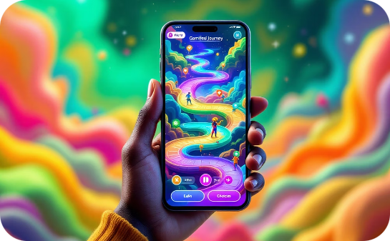
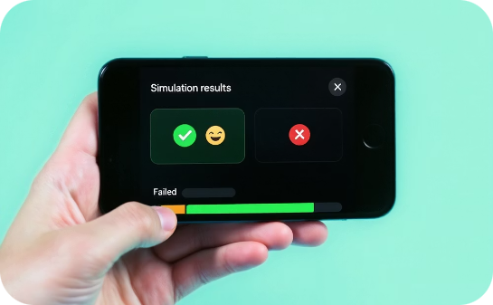

PathFinder KE Solution
PathFinder KE is a mobile gamified experience that simulates a student's academic and career journey in Kenya:
Choose Paths & Make Decisions
See Outcomes & Learn
Explore Options Before Committing
Students actively choose academic and career paths, making decisions that influence their virtual journey.
The platform simulates real-world consequences, allowing students to learn from virtual successes and failures.
PathFinder KE enables exploration of various career options in Kenya, helping students understand possibilities before making real-life commitments.

Slide 5
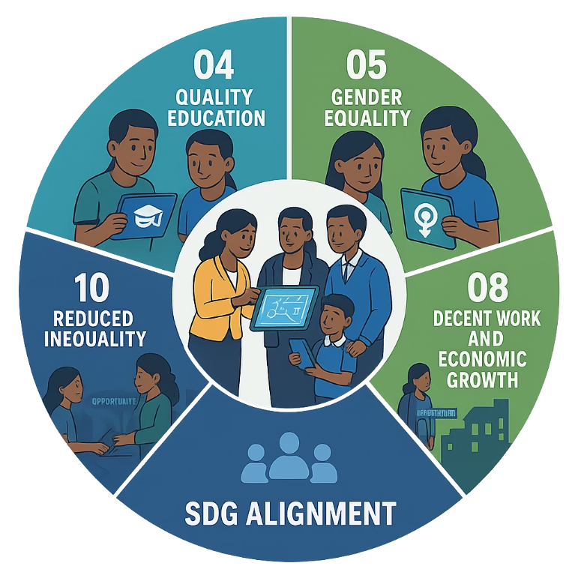
Why PathFinder KE?
Key Differentiators
Local Simulation
Gamified Career Decisions
Personalization
Offline First + Low Bandwidth UX
Community-First Model
Data Driven Paths

Slide 6








Who Uses PathFinder KE?
Teachers/Career Counsellors
Students
Government Stakeholders
Parents/Guardians

Slide 7




Experiment Design & Testing
Hypothesis
App increases career awareness and motivation.
Experiment Setup
Pilot with 100 students across 3 schools.
Metrics
Pre/post career knowledge tests
App usage statistics
Student feedback surveys

Slide 8





Impact Assessment & Refinement
2
Economic Impact
Building skilled workforce, attracting investments.
Social Impact
Empowering students, lowering unemployment, closing skills gaps.
1
3
Next Steps
Scale to more schools, develop new features.
Envisioning
Success Stories
Call to Action
Students sharing positive experiences from pilot program.
Join us to expand PathFinder KE's reach across Kenya.

Slide 9

Tools and Resources
Blender
Armorpaint
Unity game engine
FL Studio
3D modeling software
Texture painting software
Music production workstation
Game development platform

Slide 10

Conclusion: Empowering Africa's Future Workforce
Connect Interests & Education
Helping students relate subjects of interest with career paths.
Link to Job Market
Using local data for relevant career matches.
Invest in the Future
Support growth of Africa's skilled workforce.

Slide 11





Meet the Team
Benzil Emmanuel
Parsley Njoroge
Patrick Leon
Project Lead/Prompt Engineer
Researcher
Programmer/ML Engineer
Brian Kinyua
Oliver Gitonga
Game developer
UI/UX Designer

